Slide 1

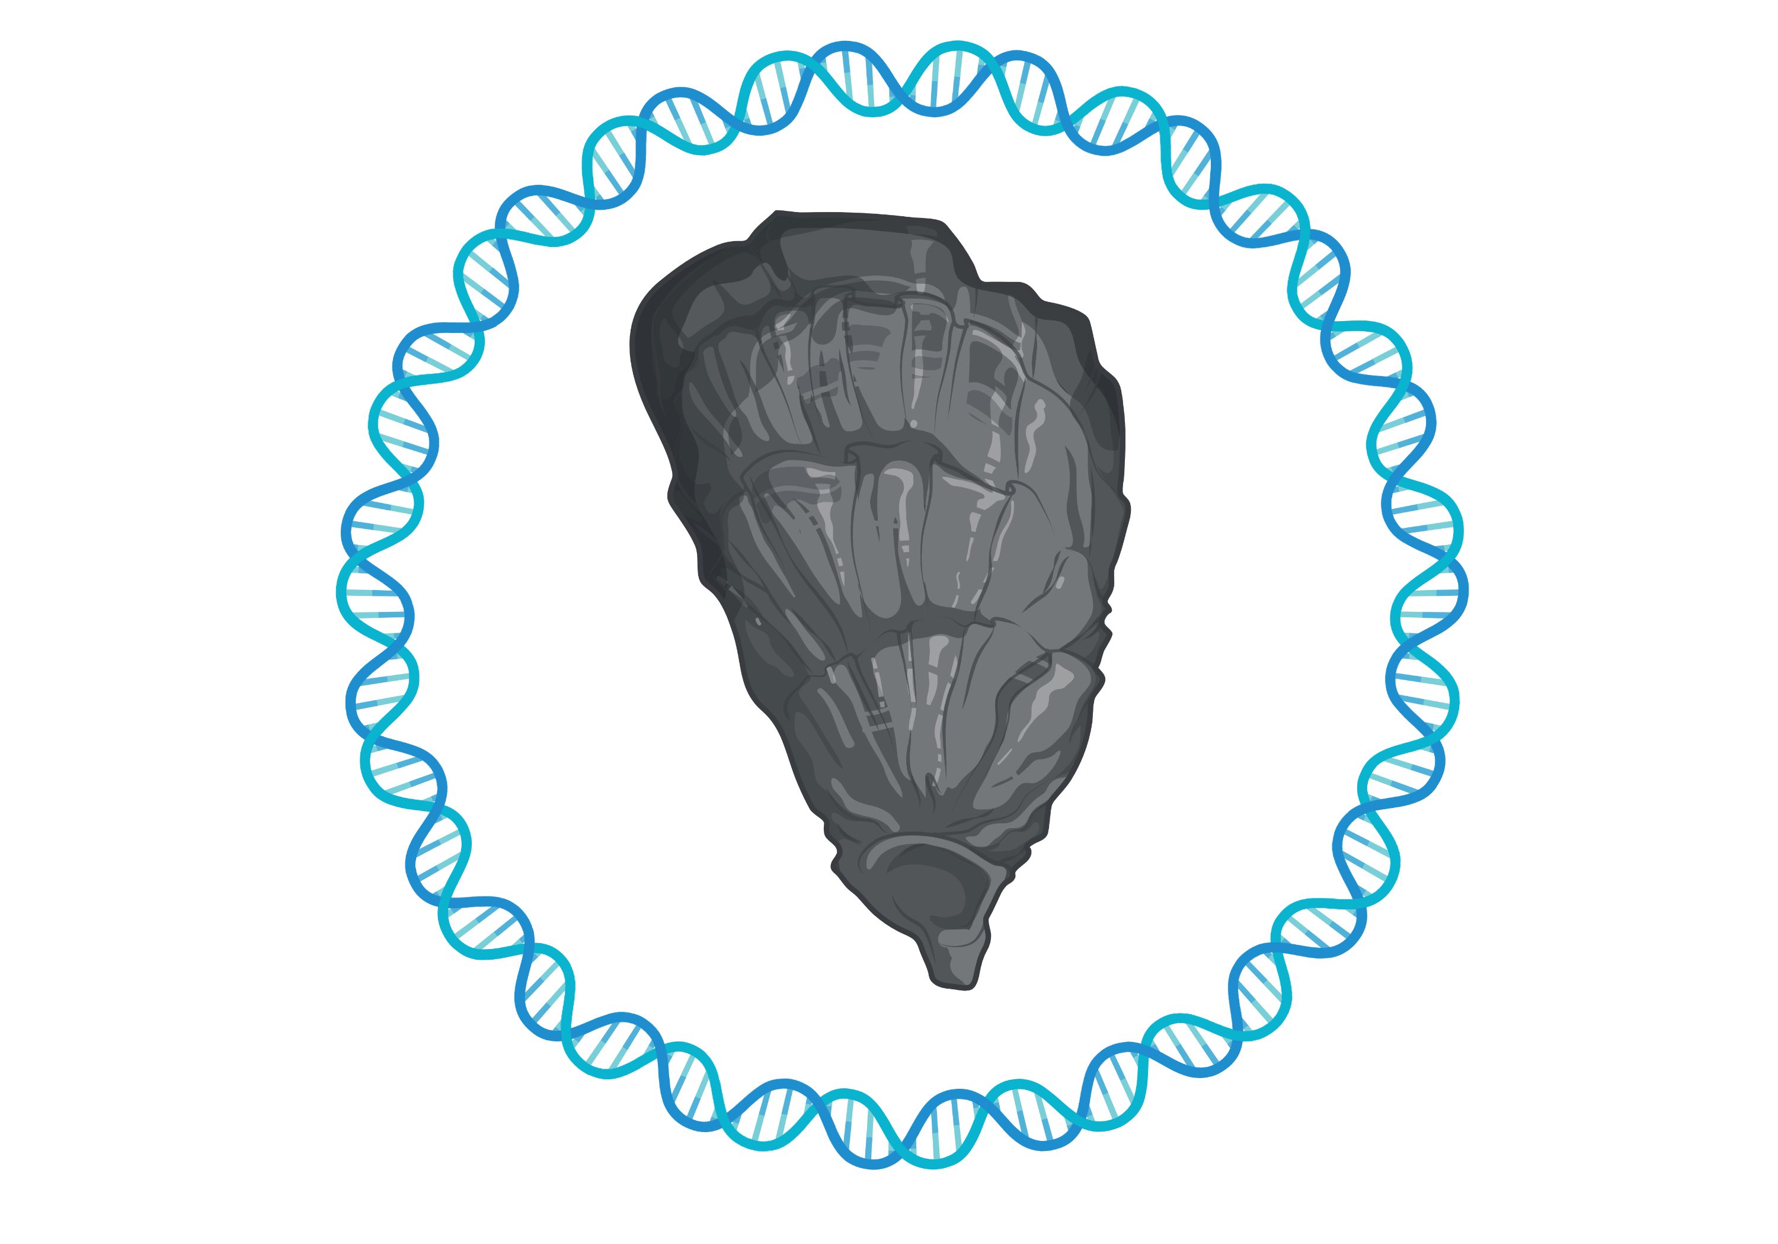

Development of tool to sequence the exome of any organism rapidly and cost-effectively
Jacob Michael Green
May 3rd, 2021
Qualifying Exam
Committee: Jonathan B. Puritz, Ph.D., Marta Gomez-Chiarri, Ph.D., Dina Proestou, Ph.D., and Bryan Dewsbury, Ph.D.
University of Rhode Island
Department of Biological Sciences

Slide 2
What are we working through today?
Background
Study Objectives
Research Design
Next Steps

Slide 3
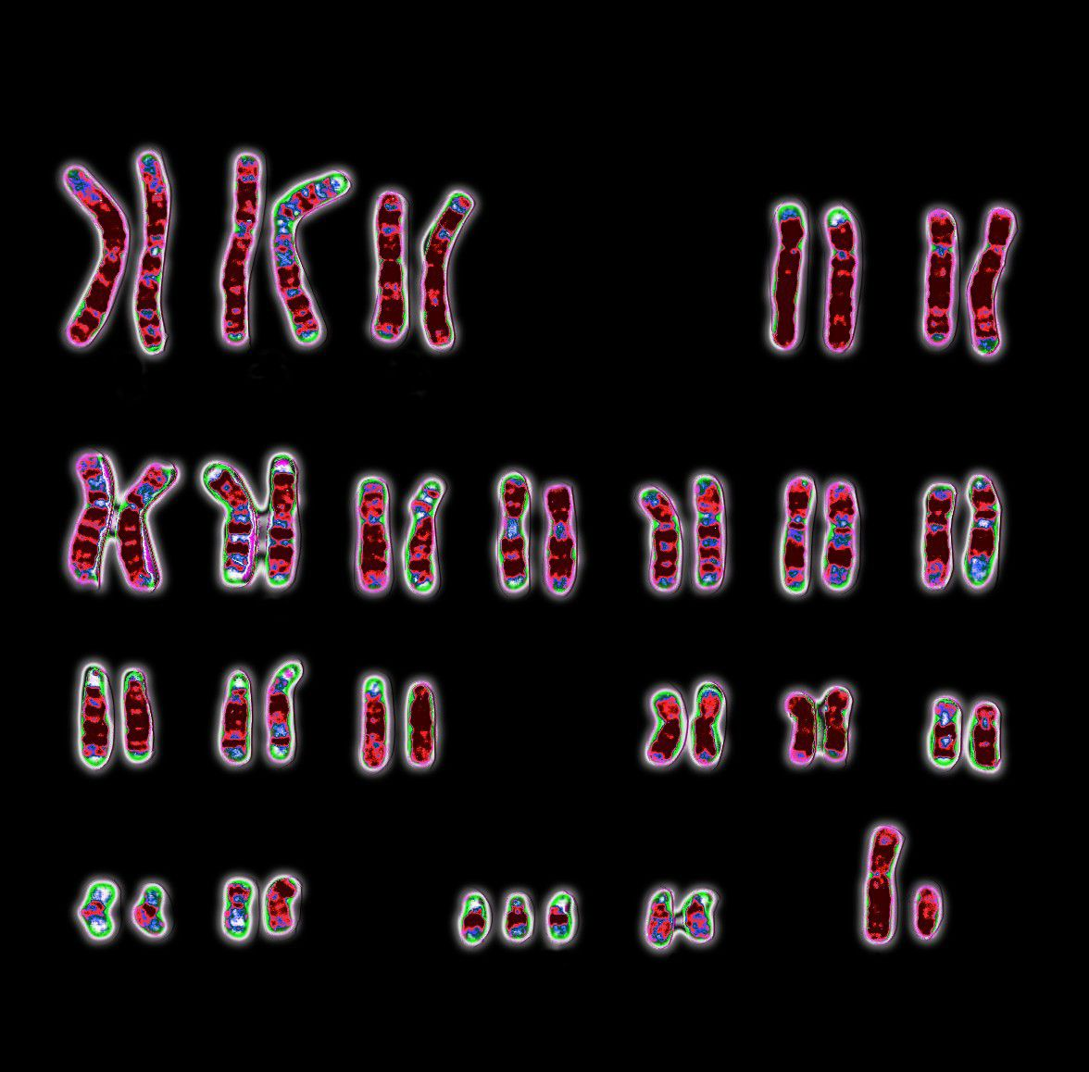
“Life is the universe developing a memory” – Dr. Lee Cronin
https://www.britannica.com/science/karyotype

Slide 4
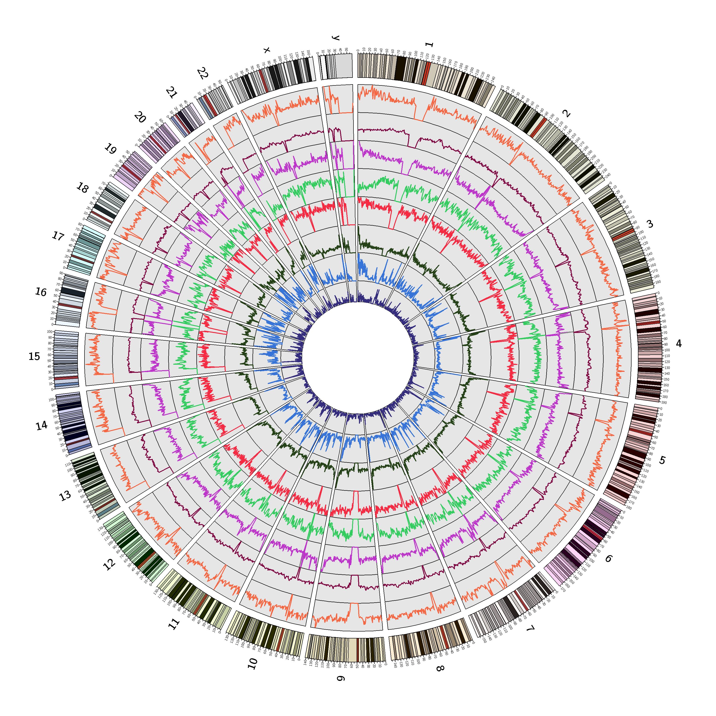
Next generation sequencing (NGS) provides unique insights into our genetic memory
“Genetic memory resides in specific molecules of nucleic acid” – Marshall Nirenberg Nobel lecture 1968
https://nonb-abcc.ncifcrf.gov/apps/site/visualization/

Slide 5
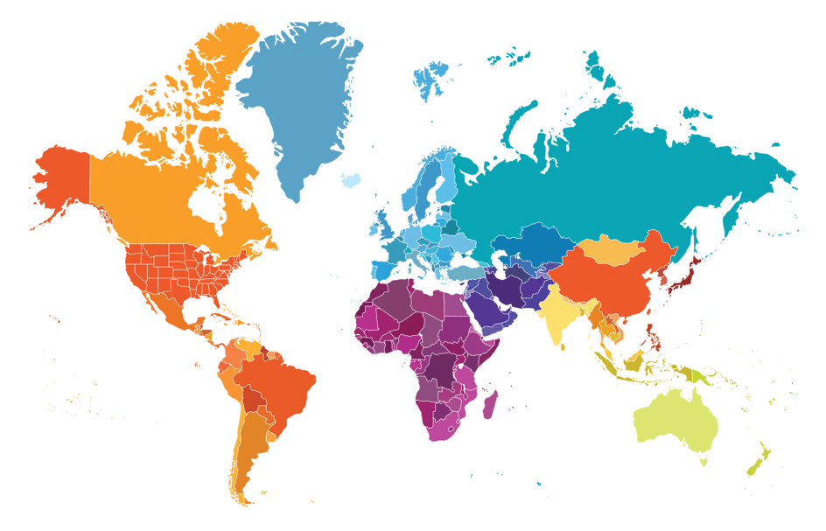
Evolutionary biology seeks to explore “our” collective genetic memory
https://www.23andme.com/roots/

Slide 6

Issues of time, money, scale, and resources with NGS
Human genome project
Build human haploid reference genome
>70% reference single male from Buffalo, NY
Cost: 3 billion dollars
Multiple Institutions
Time: 13 years
Oseogawa et al. 2001

Slide 7
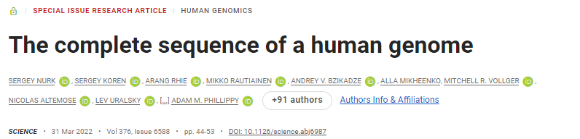
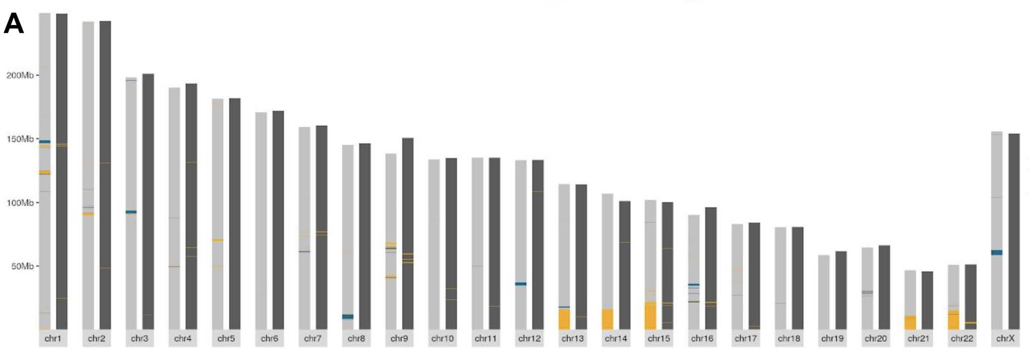
WRONG!
2003 genome ~ 85 % of the genome
https://doi.org/10.1126/science.abj6987

Slide 8


Slide 9

Non-model and obscure model species need tools too!
Genome reduction methods are needed to apply NGS technologies to other species

Slide 10
Transform proof of concept genome reduction method into a readily available tool to sequence the exome of any organism
Phase 1: Develop an open source bioinformatic pipeline to analyze sequence data
Phase 2: Molecular laboratory protocol optimization and improvement
Phase 3: Compare and validate tool with traditional capture methods and WGS

Slide 11
Oysters are a unique non-model marine invertebrate
Habitat creator
Water filterer
Shoreline protection
Economic resource

Slide 12
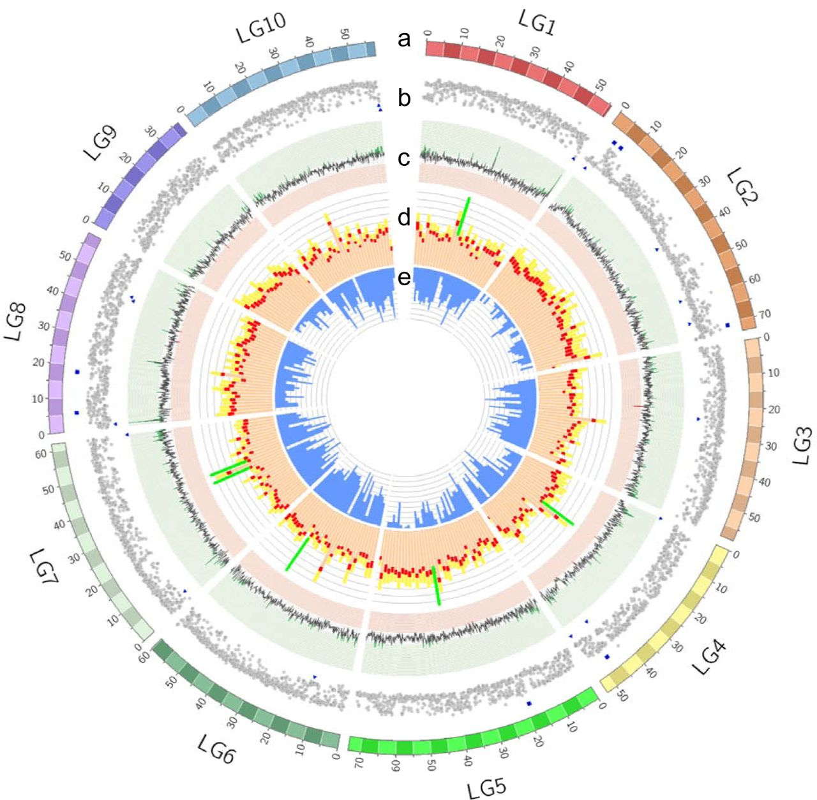
Oysters are a unique non-model marine invertebrate with a complex genome
Available datasets: reference genome, transcriptome, linkage maps, SNP markers and arrays
Widespread duplication
High rates of polymorphism
Many gene variants
Many uncharacterized regions
Peñaloza et al. 2020
Notes:
Oyster chromosomes (LG1–LG10 on a Mb scale).
short-read coverage plot. Coverage within 2SD of the mean are shown as grey circles. Abnormal sequence coverage (± 2SD form the mean) are indicated with a blue square or triangle, respectively.
GC content percentage (>35% in green; <31% in red).
Distribution of repeat elements: DNA transposons (light orange bar), retrotransposon TEs (red bar) and novel repeat elements (yellow bar). The location of centromeres is indicated with a green line.
Gene density (range 50-150).

Slide 13
Population genomic methods for non-model species
Aim of study | Optimal sequencing method
Population subdivision, migration rates, population change through time | RAD
Mikhail V. Matz 2017

Slide 14
Population genomic methods for non-model species
Aim of study | Optimal sequencing method
Population subdivision, migration rates, population change through time | RAD
Genes under selection | Exome Sequencing
Mikhail V. Matz 2017

Slide 15
Population genomic methods for non-model species
Aim of study | Optimal sequencing method
Population subdivision, migration rates, population change through time | RAD
Genes under selection | Exome Sequencing
Selection signatures and genomic speciation | Low coverage Whole Genome Seq or PoolSeq
Mikhail V. Matz 2017

Slide 16
Population genomic methods for non-model species
Aim of study | Optimal sequencing method
Population subdivision, migration rates, population change through time | RAD
Genes under selection | Exome Sequencing
Selection signatures and genomic speciation | Low coverage Whole Genome Seq or PoolSeq
Molecular acclimatization and acclimation | RNAseq or TagSeq
Mikhail V. Matz 2017

Slide 17
Population genomic methods for non-model species
Aim of study | Optimal sequencing method
Population subdivision, migration rates, population change through time | RAD
Genes under selection | Exome Sequencing
Selection signatures and genomic speciation | Low coverage Whole Genome Seq or PoolSeq
Molecular acclimatization and acclimation | RNAseq or TagSeq
Genome-wide epigenetic inference | EpiRAD, Methyl RAD, MDB-Seq
Mikhail V. Matz 2017

Slide 18
Population genomic methods for non-model species
Aim of study | Optimal sequencing method | Minimal reference
Population subdivision, migration rates, population change through time | RAD | None
Genes under selection | Exome Sequencing | De novo transcriptome
Selection signatures and genomic speciation | Low coverage Whole Genome Seq or PoolSeq | Draft genome
Molecular acclimatization and acclimation | RNAseq or TagSeq | None or de novo transcriptome
Genome-wide epigenetic inference | EpiRAD, Methyl RAD, MDB-Seq | None for RAD, de novo transcriptome
Mikhail V. Matz 2017

Slide 19
Population genomic methods for non-model species
Aim of study | Optimal sequencing method | Minimal reference | Optimal Reference
Population subdivision, migration rates, population change through time | RAD | None | Draft genome of sister species
Genes under selection | Exome Sequencing | De novo transcriptome | Well annotated genome
Selection signatures and genomic speciation | Low coverage Whole Genome Seq or PoolSeq | Draft genome | Well annotated genome
Molecular acclimatization and acclimation | RNAseq or TagSeq | None or de novo transcriptome | Well annotated genome
Genome-wide epigenetic inference | EpiRAD, Methyl RAD, MDB-Seq | None for RAD, de novo transcriptome | Well annotated genome
Mikhail V. Matz 2017

Slide 20
The exome within the genome
The entire collection of exons contained in the genome
DNA sequences that code for proteins
Changes to these regions have the potential to change function

Slide 21
The exome: the ultimate genome reduction
RADseq
Cheap
May not sample target genes

Slide 22
The exome: the ultimate genome reduction
RADseq
Cheap
May not sample target genes
RNAseq
Relatively expensive

Slide 23
The exome: the ultimate genome reduction
RADseq
Cheap
May not sample target genes
RNAseq
Relatively expensive

Slide 24
The exome: the ultimate genome reduction
RADseq
Cheap
May not sample target genes
RNAseq
Relatively expensive
Allele specific expression

Slide 25
The exome: the ultimate genome reduction
RADseq
Cheap
May not sample target genes
RNAseq
Relatively expensive
Allele specific expression

Slide 26
The exome: the ultimate genome reduction
RADseq
Cheap
May not sample target genes
RNAseq
Relatively expensive
Allele specific expression
Exome capture
Requires an annotated transcriptome, preferably genome
Requires synthesized probes

Slide 27





Traditional exome capture
Probes
Hybridize to DNA library
Capture
Wash, elute, PCR enrich
~ 10 K to probe 100 samples
Sequence

Slide 28
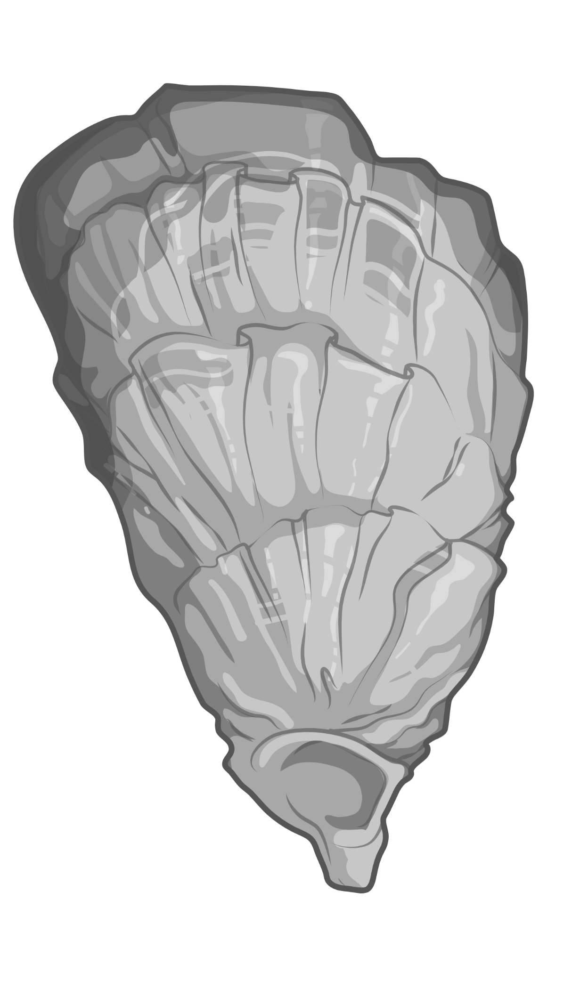
Expressed exome capture sequencing (EecSeq)
Probes
Hybridize to DNA library
Capture
Wash, elute, PCR enrich
Sequence

Slide 29
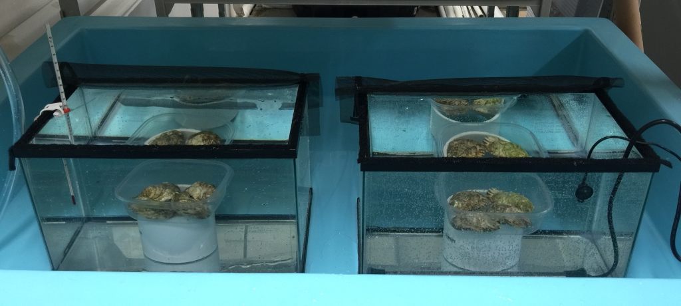
EecSeq proof of concept
Simple heat shock exposure
4 exposed individuals at 36 ºC for 1 hour
4 control individuals at ambient (12 ºC for 1 hour)
Puritz & Lotterhos 2018

Slide 30

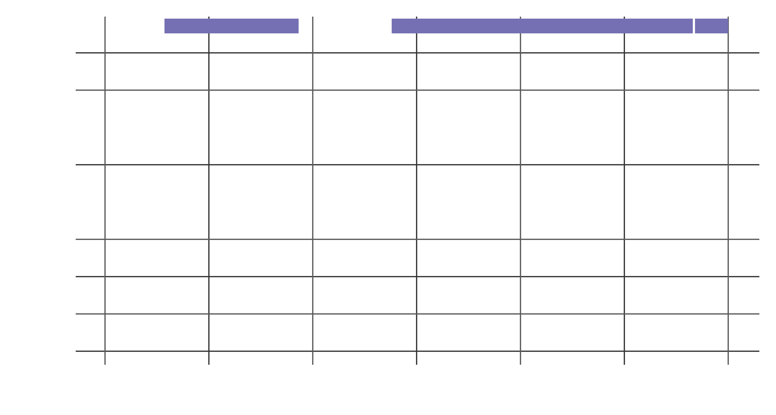
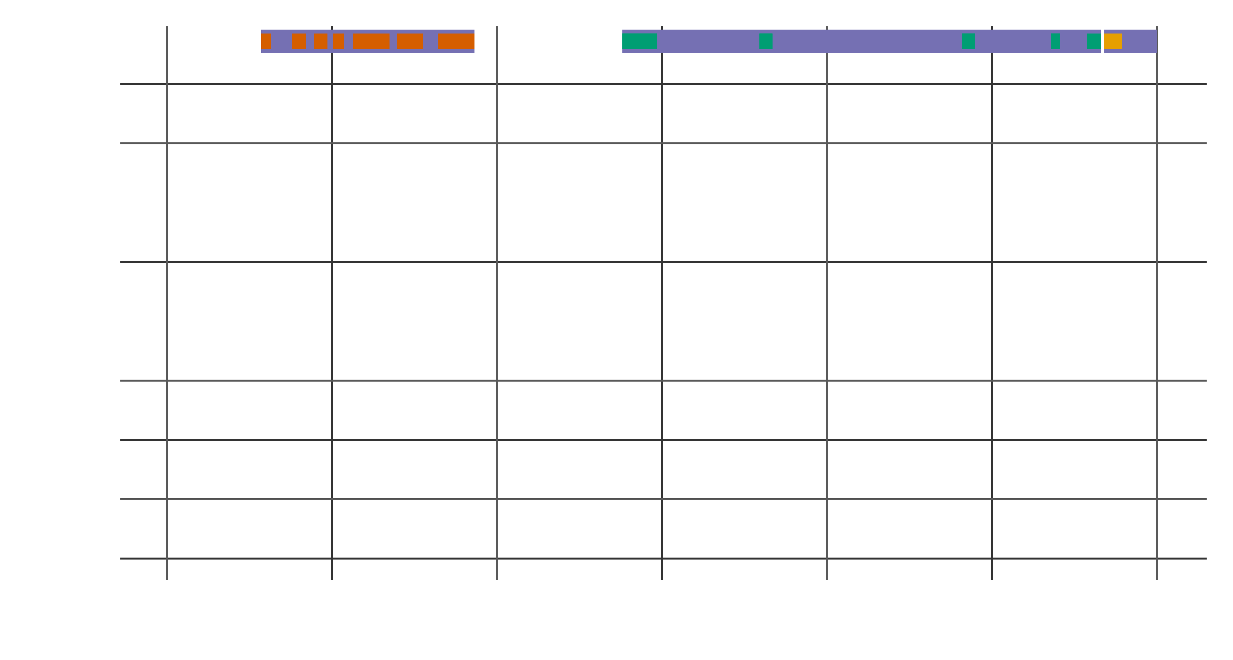
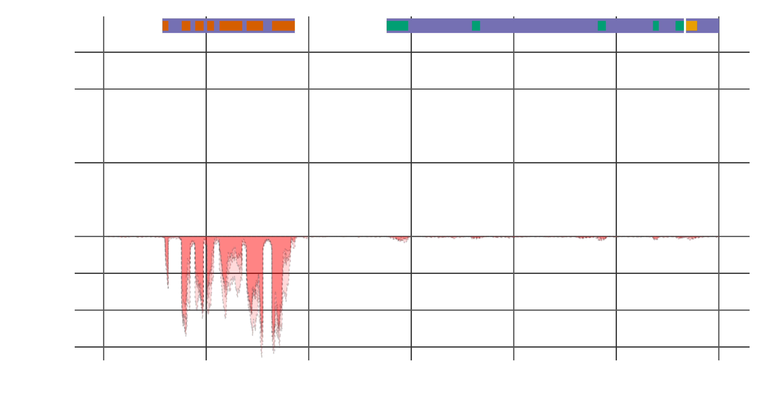

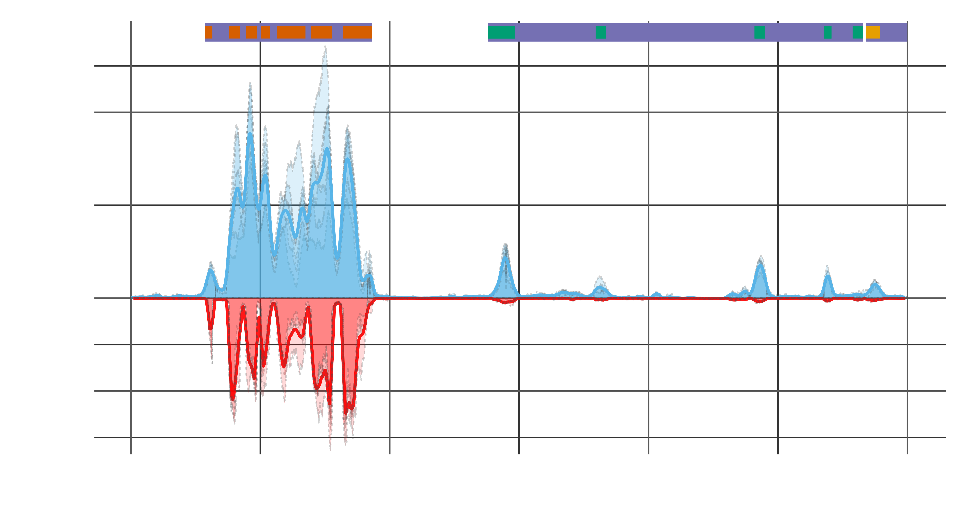
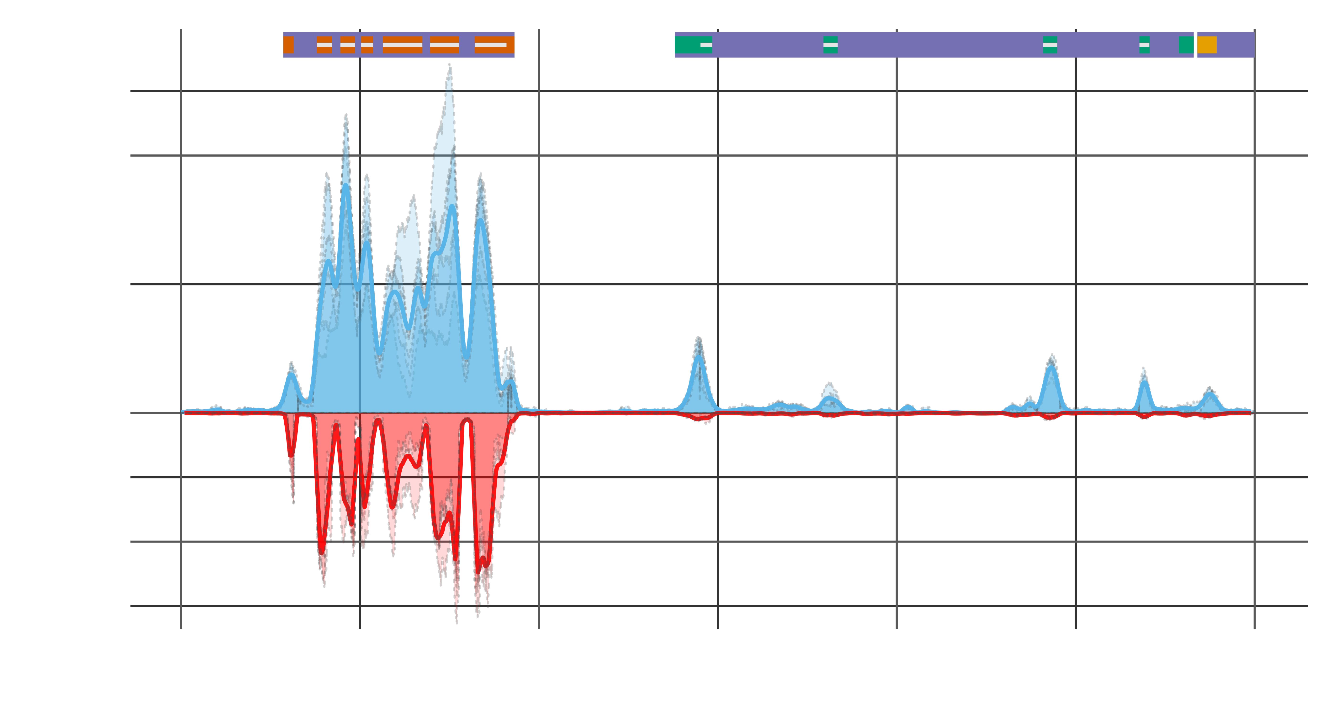
EecSeq targets expressed exons

Slide 31
EecSeq data is comparable to RNAseq data
Puritz & Lotterhos 2018

Slide 32
EecSeq benefits to identifying genes under selection
Removes the need for any reference
Removes the cost and time associated with probe synthesis
Only targets expressed exons
Delivers consistent and efficient exome enrichment
Is comparable to traditional methods of exome capture
Generates thousands of exome SNPs cost effectively
Puritz & Lotterhos 2018

Slide 33
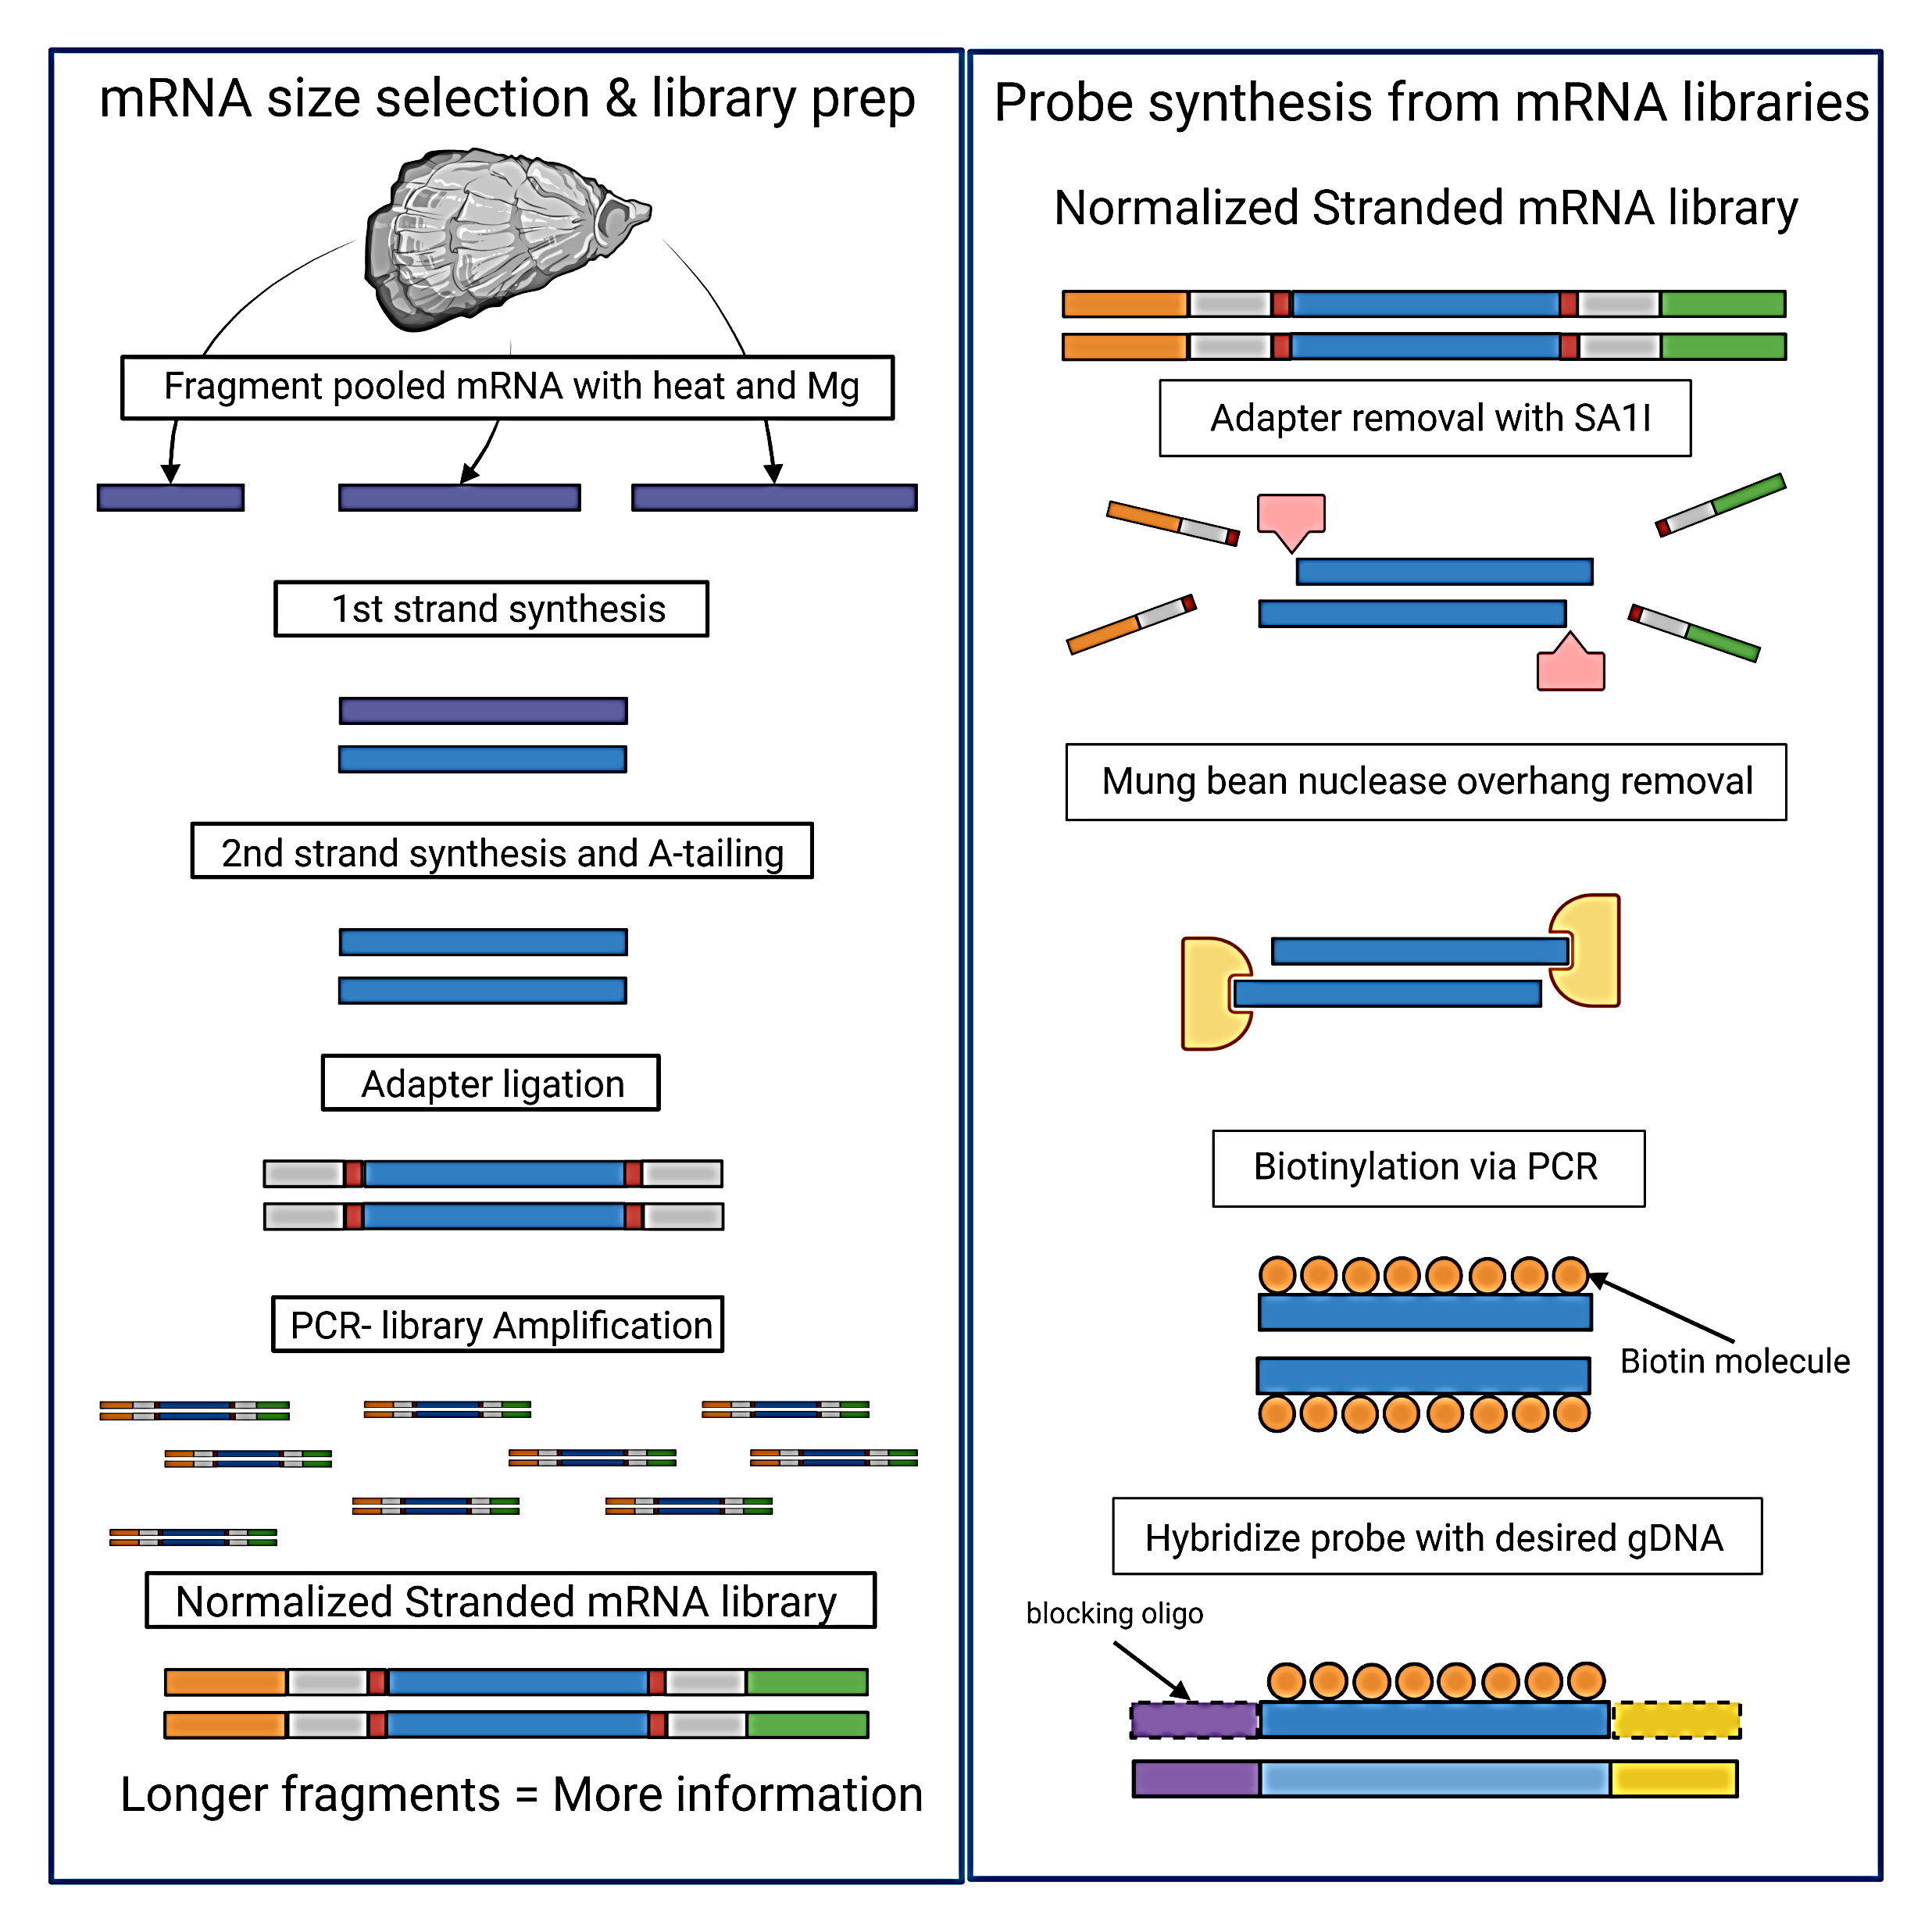
How does EecSeq work?

Slide 34
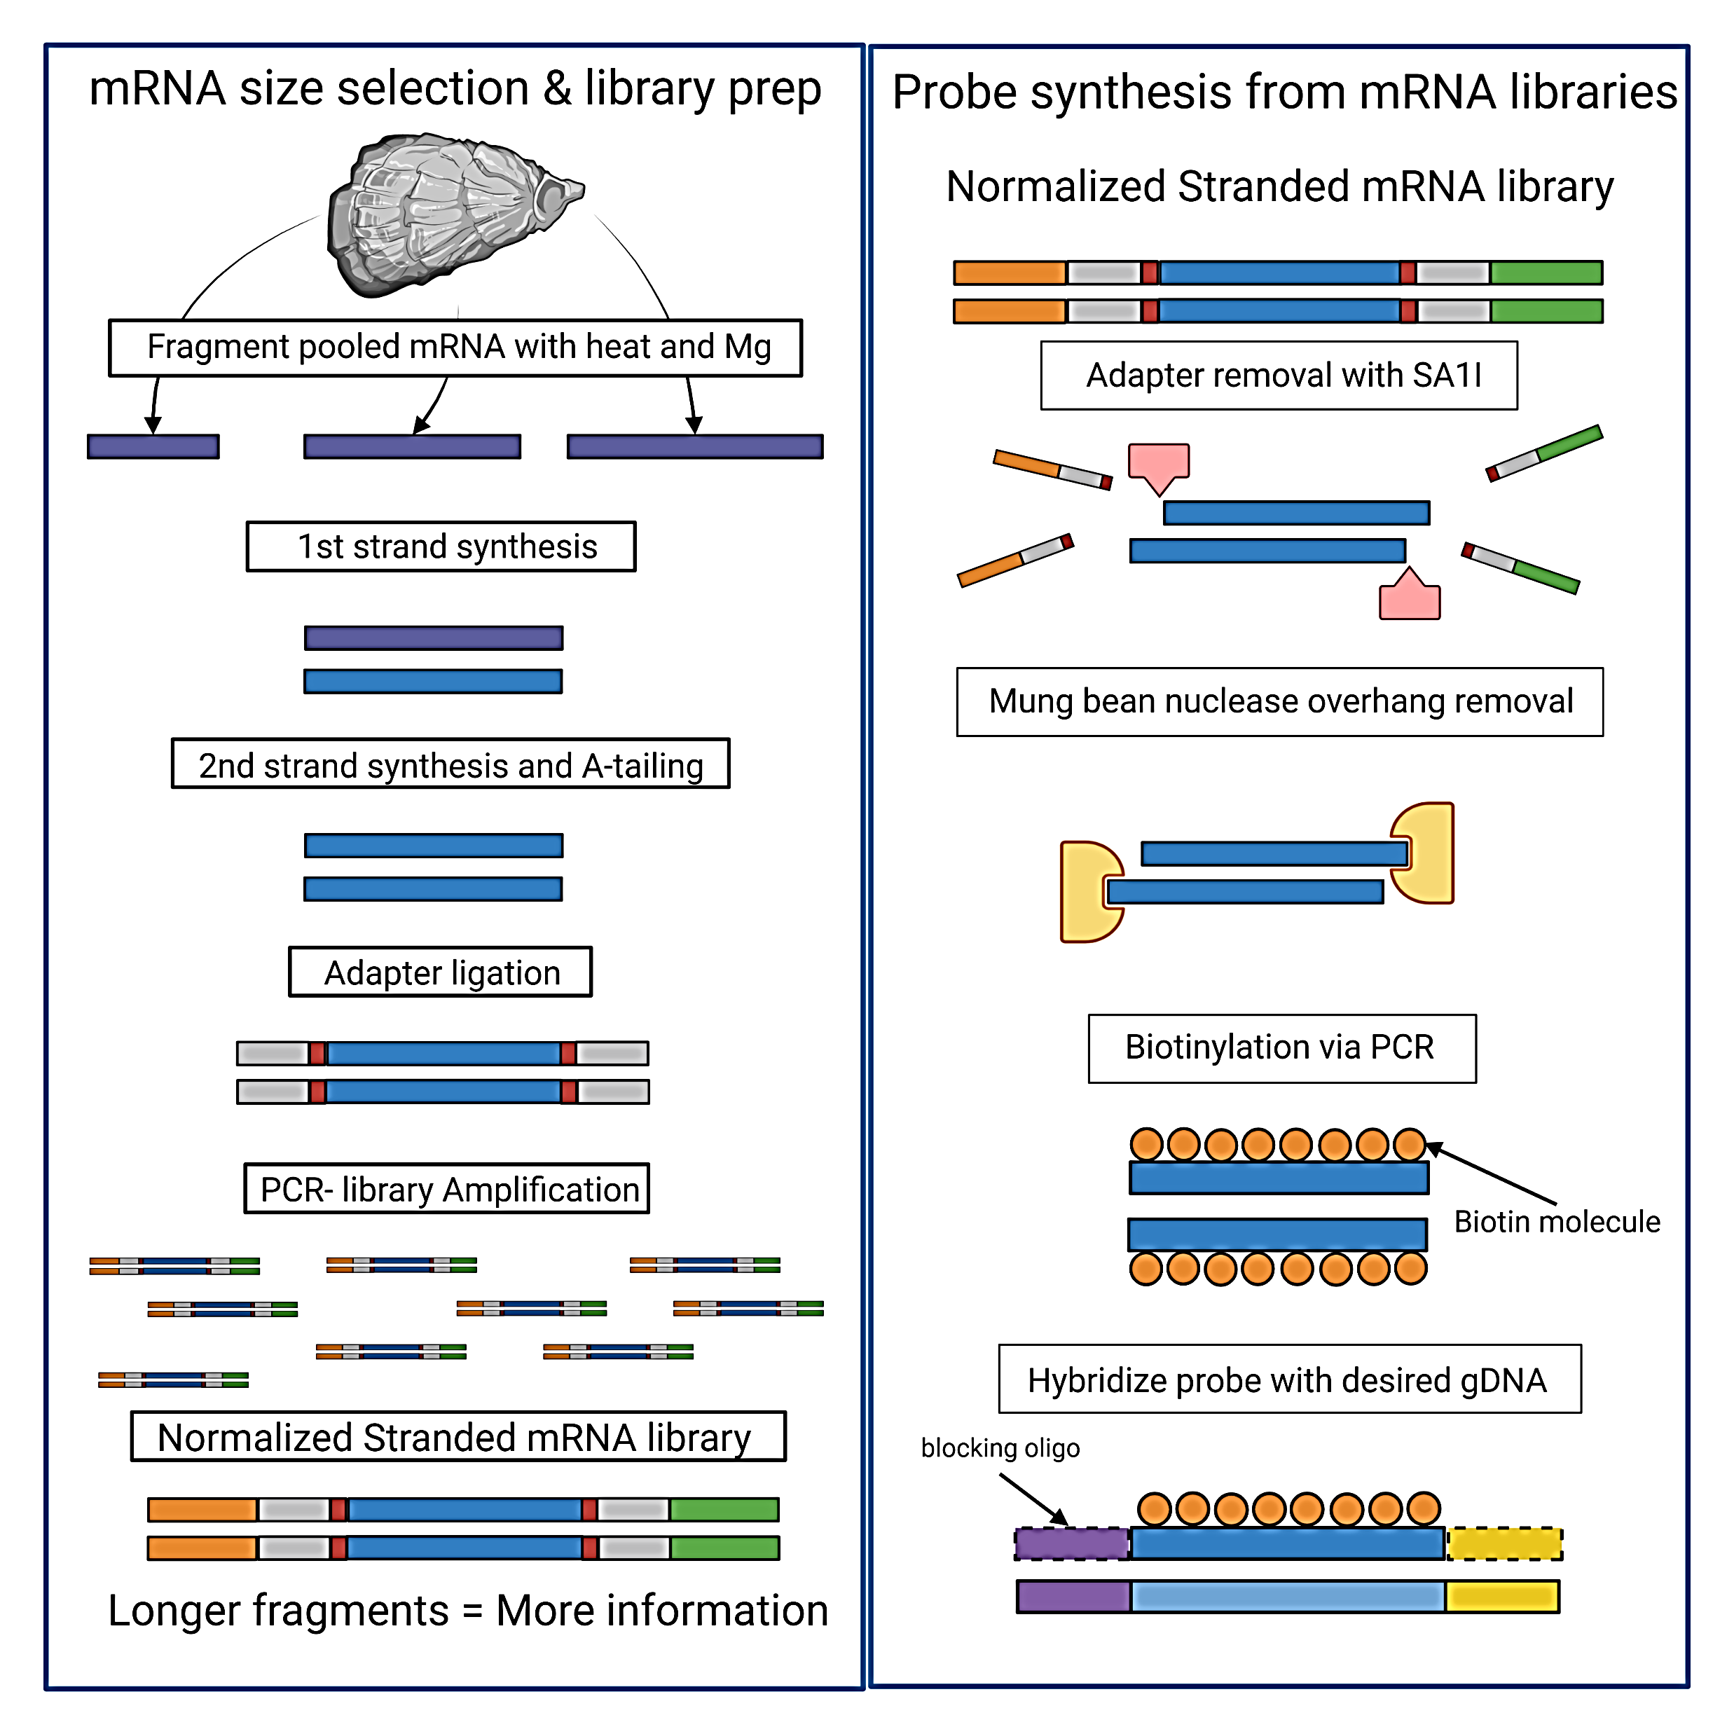
How does EecSeq work?

Slide 35
How does EecSeq work?

Slide 36
How does EecSeq work?

Slide 37
How does EecSeq work?

Slide 38
How does EecSeq work?

Slide 39
How does EecSeq work?

Slide 40
How does EecSeq work?

Slide 41
How does EecSeq work?

Slide 42
How does EecSeq work?
Ligate blocking oligo to probe

Slide 43
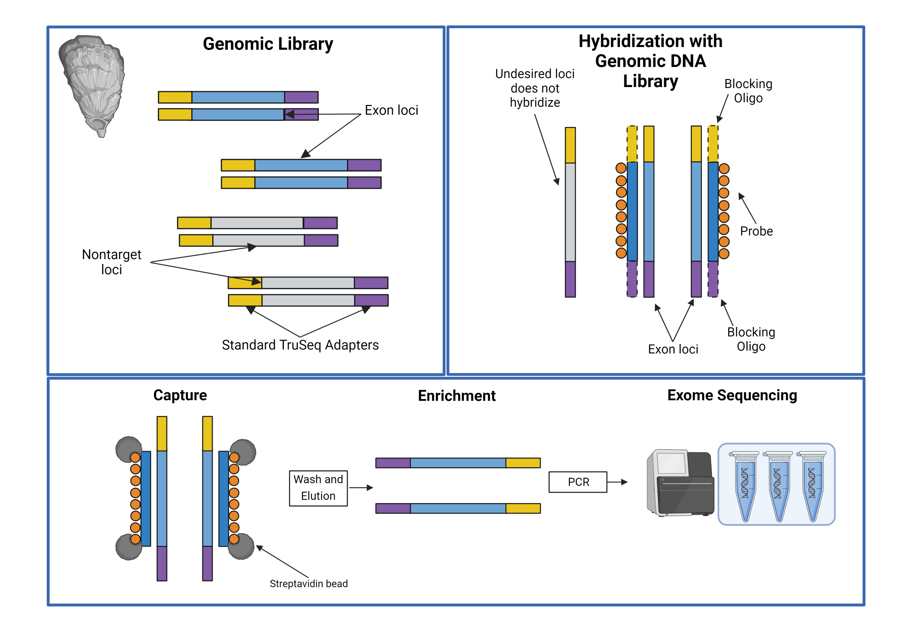
How does EecSeq work?

Slide 44
How does EecSeq work?

Slide 45
How does EecSeq work?

Slide 46
Transform proof of concept into a readily available method to sequence the exome of any organism
Objective 1: Develop an open source bioinformatic pipeline to analyze EecSeq Data
Objective 2: Molecular laboratory protocol optimization and improvement
Objective 3: Compare and validate EecSeq with traditional capture methods and WGS

